Slide 1
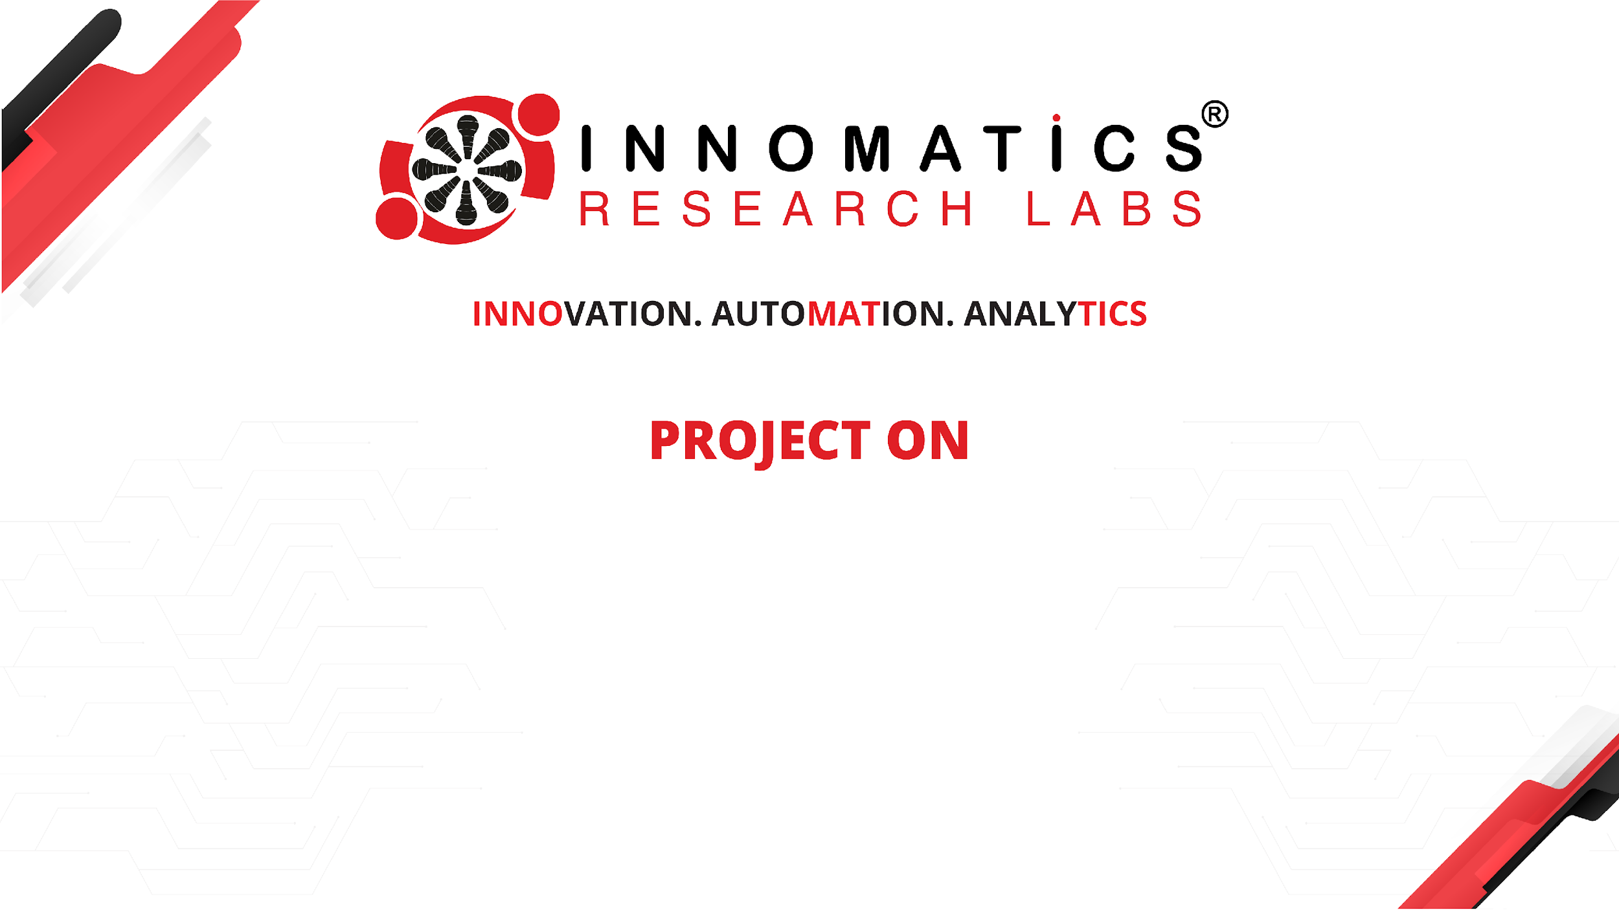
VIRTUAL MOUSE AND KEYBOARD
Kakunuri Prudhvi
BATCH NO:436
Innomatics Research Labs, Dilsukhnagar

Slide 2

About me:
I am K. Prudhvi
I am a Computer Science Engineering graduate from Aurora’s Scientific and Technological Institute.
I see Data Science & AI as the future of Technologies and Businesses.
Portfolio Website: prudhvikakkunuri.github.io
LinkedIn: www.linkedin.com/in/prudhvi-k-387257222
GitHub: https://github.com/prudhvikakkunuri

Slide 3
CONTENTS
Problem Statement
Objective
Technologies Used
Hand Tracking Module
Features Implemented
Advantages
Limitations
Conclusion

Slide 4
INTRODUCTION
This project develops a real-time Virtual Mouse and Keyboard using hand gesture recognition.
It enables users to control cursor movement, clicks, and typing without physical input devices.
The system uses Computer Vision (OpenCV & MediaPipe) to provide touchless and intuitive human–computer interaction.

Slide 5
PROBLEM STATEMENT
Traditional computer interaction relies heavily on physical input devices such as a mouse and keyboard. However:
Physical devices require direct touch and surface support
They are not accessible for individuals with mobility impairments
In sterile environments (hospitals, labs), touch-based systems increase contamination risk
During presentations or public displays, physical control devices limit mobility and flexibility
Hardware failures (mouse/keyboard damage) interrupt productivity

Slide 6
Business Understanding
Need a touch-free way to control computers in shared and hygiene-sensitive environments.
Goal: Control mouse actions using hand gestures via a webcam.
Data Understanding
Input data is real-time video frames from the webcam.
Hand landmarks (21 key points) are extracted using MediaPipe.
Data Preparation
Preprocess frames (resize, RGB conversion).
Filter detection using confidence thresholds.
Define control frame and normalized coordinates.
Remove noise using smoothening.

Slide 7
Modeling
Use MediaPipe’s pre-trained hand tracking model.
Implement gesture logic using finger states and distance thresholds.
Map gestures to mouse actions (move, click, scroll, drag, screenshot).
Evaluation
Test gesture accuracy and response time.
Measure FPS for real-time performance.
Validate usability under different lighting and backgrounds.
Deployment
Run the system as a real-time desktop application.
Share code with requirements.txt for easy setup.
Can be packaged as a lightweight tool for daily use.

Slide 8
TECHNOLOGIES USED
Python – Programming language
OpenCV – Camera handling & UI
MediaPipe – AI-based hand tracking
NumPy – Mathematical mapping
AutoPy – Mouse movement & click

Slide 9
HAND TRACKING MODULE
Tracks finger positions
Identifies index finger
Calculates distance between fingers
Example:
Index finger tip → Cursor movement
Thumb + Index distance → Click
Index Finger Punch →(To type Text)

Slide 10
FEATURES IMPLEMENTED
Real-time hand tracking
Touchless mouse movement
Click on keys by placing the finger
Action feedback on screen

Slide 11
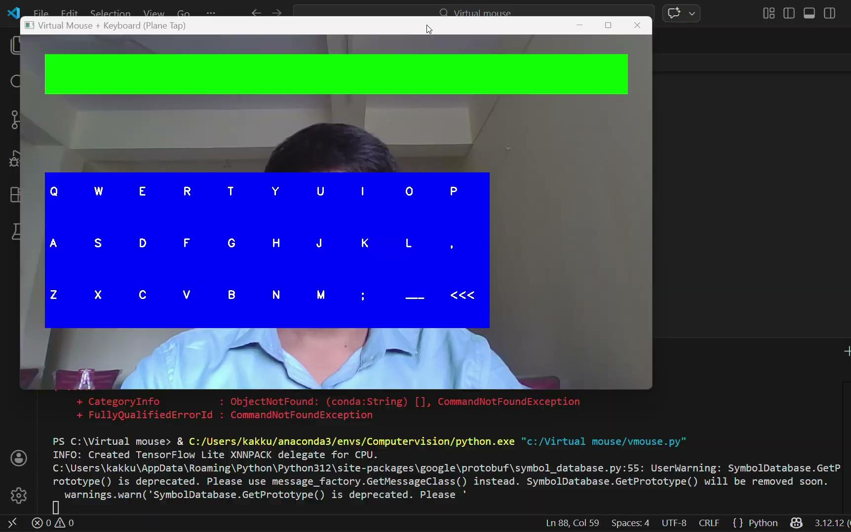

Slide 12
ADVANTAGES
Contactless interaction
Useful for hygiene environments
Accessibility support
No external hardware required
Cost-effective solution

Slide 13
LIMITATIONS
Depends on lighting conditions
Background noise may affect detection
Needs good camera quality
Slight delay in low-end systems

Slide 14
CONCLUSION
Successfully built an Virtual Mouse and Keyboard using computer vision.
Demonstrates practical application of hand tracking & gesture recognition.
Project shows real-time AI interaction with system hardware.
Can be extended for smart systems and accessibility tools.

Slide 15
THANK
YOU

